Slide 1
DBMS Mini Project : Hotel and Vehicle Booking System
By : Deepak
TE-A
Roll : 23

Slide 2
Objective
Provide hassle free room bookings in a hotel.
Provides better management facilities.
Shows availabilities, types(AC/Non AC) of rooms.
Helps the customers to rent vehicles from the hotel.
Shows the price, types and availabilities of different vehicles.

Slide 3
Contents
Introduction
ER Diagram
Technical Requirements
Database connectivity
Proposed system
Conclusion

Slide 4
Introduction
The main focus of this project is to provide the facilities of hotel management and vehicle rental system like booking rooms, rent vehicles, checking availabilities of vehicles and rooms in the hotel.
Intended user is the hotel manager.

Slide 5
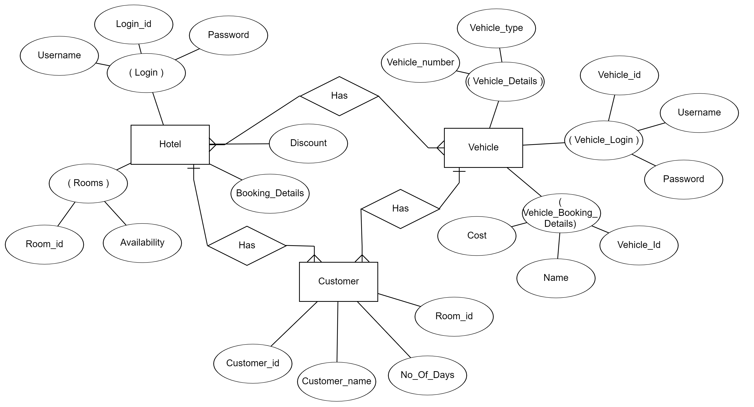
ER Diagram

Slide 6
Technical Requirements
Software Requirements
Windows 7/8/10 or Linus Operating System
NetBeans 8.2 or above
Java JDK 12
JDBC Driver
MySQL
Hardware Requirements
Core i5 processor
4 GB RAM
50 GB HDD

Slide 7
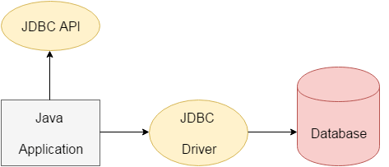
Database Connectivity
The tool used in this project for database connectivity is JDBC.
What is JDBC?
JDBC stands for Java Database Connectivity. JDBC is a Java API to connect and execute the query with the database. It is a part of JavaSE (Java Standard Edition). JDBC API uses JDBC drivers to connect with the database.
We can use JDBC API to access tabular data stored in any relational database. By the help of JDBC API, we can save, update, delete and fetch data from the database.

Slide 8
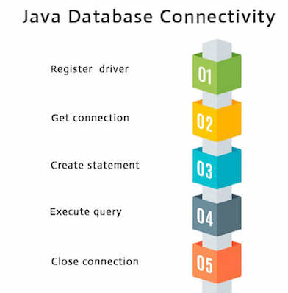
There are 5 steps to connect any java application with the database using JDBC. These steps are as follows:

Slide 9
1) Register the driver class :
The forName() method of Class is used to register the driver class. This method is used to dynamically load the driver class.
Eg :
Class.forName(“com.mysql.jdbc.Driver”);
2) Create the connection object :
The getConnection() method of DriverManager class is used to establish connection with the database.
Eg:
Connection conn=DriverManager.getConnection("jdbc:mysql://localhost/DB",”root”,password);
3) Create the Statement object :
The createStatement() method of Connection interface is used to create statement. The object of statement is responsible to execute queries with the database.
Eg :
Statement stmt=conn.createStatement();

Slide 10
4) Execute the query :
The executeQuery() method of Statement interface is used to execute queries to the database. This method returns the object of ResultSet that can be used to get all the records of a table.
Eg :
ResultSet rs=stmt.executeQuery("select * from emp");
5) Close the connection object :
By closing connection object statement and ResultSet will be closed automatically. The close() method of Connection interface is used to close the connection.
Eg :
con.close();

Slide 11
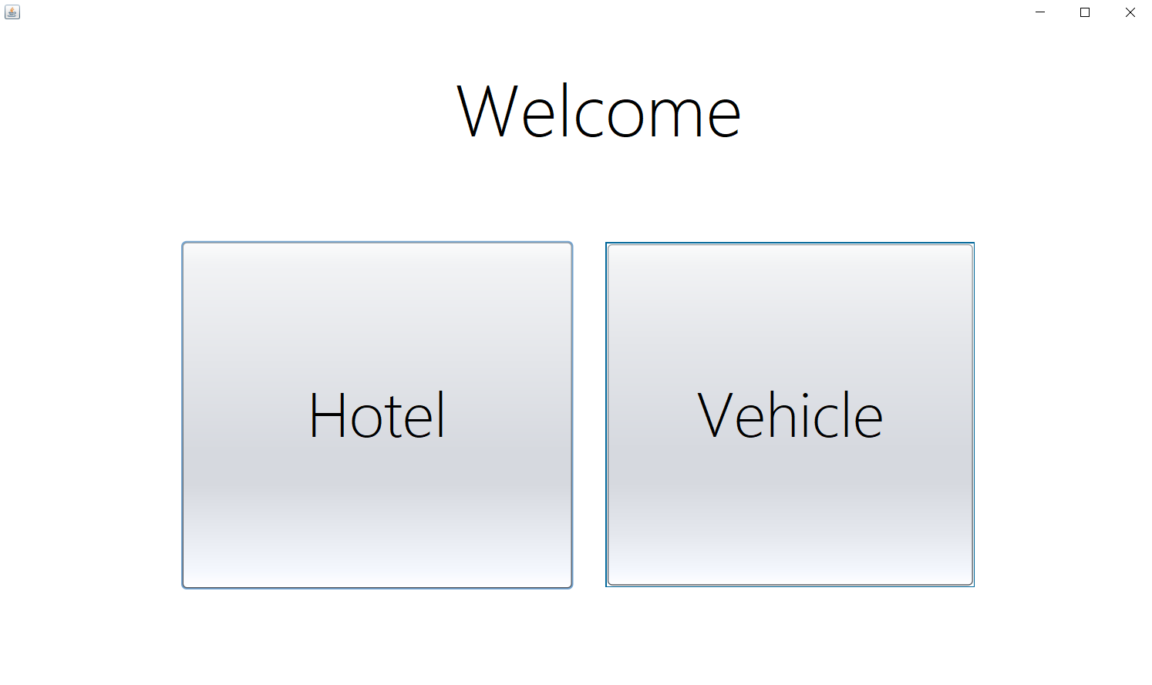
Proposed System

Slide 12
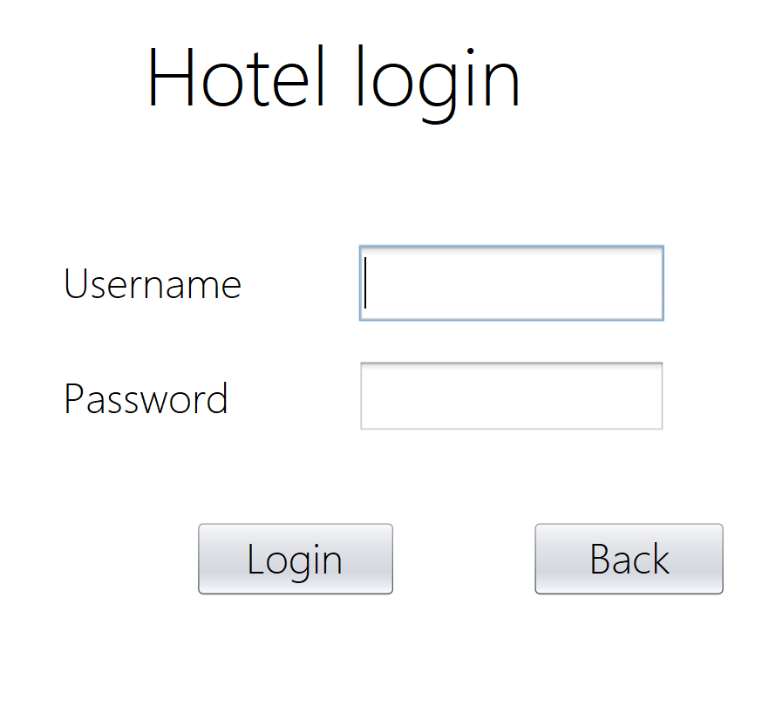
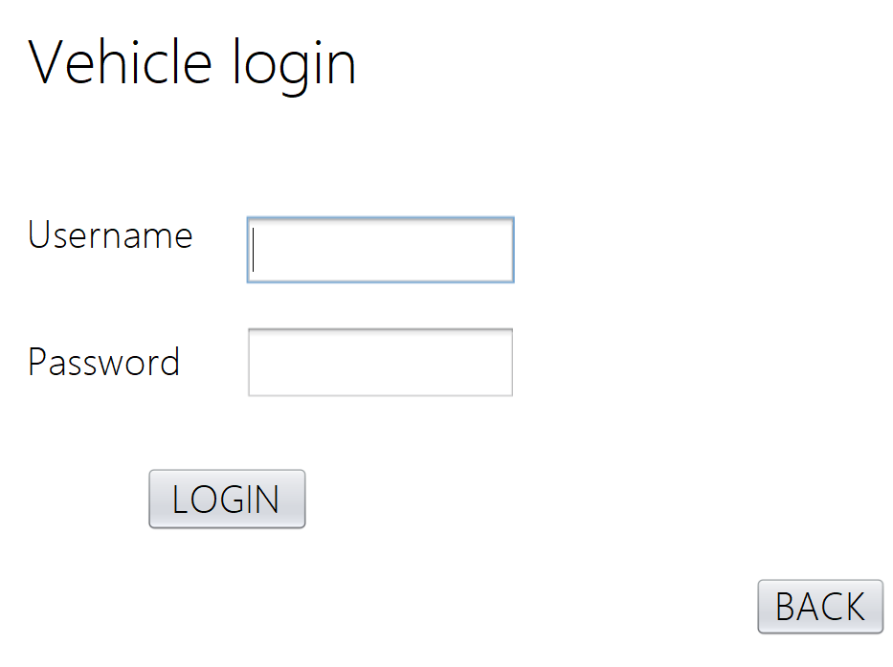

Slide 13
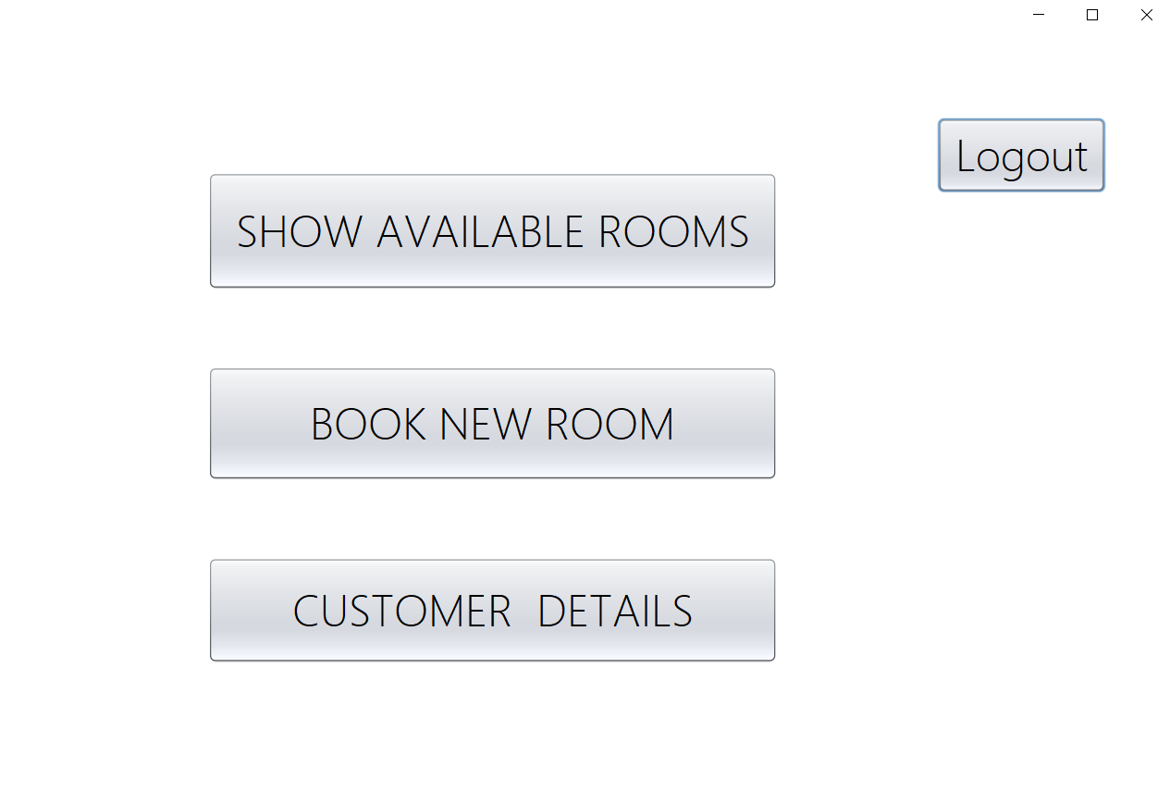

Slide 14
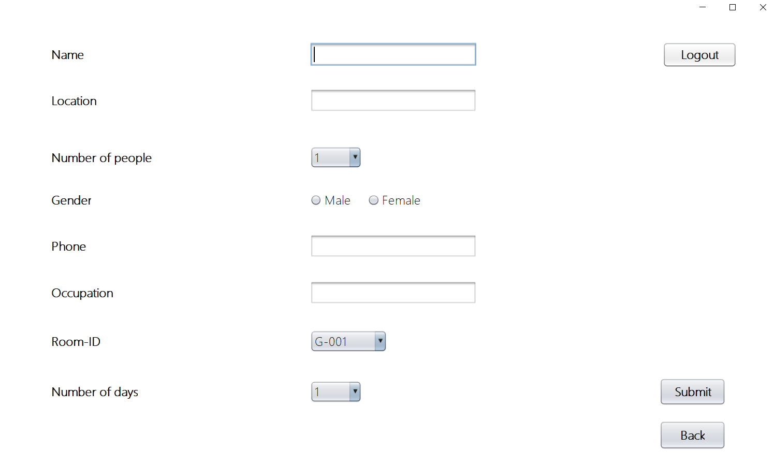

Slide 15
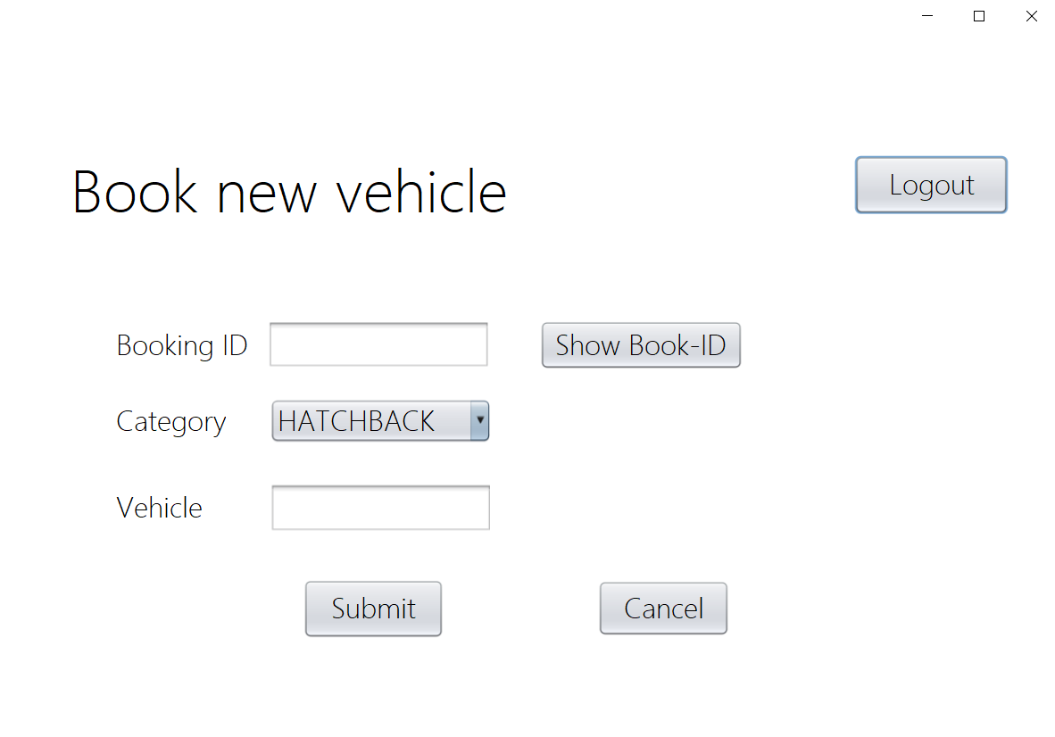

Slide 16
Conclusion
Here, a system is developed which provides with the facilities like booking rooms in a hotel, checking availability of rooms and also provides vehicle rental facilities in which we can book different vehicles according to our needs.
New features can also be added in the system in which we can track the rented vehicles.

Slide 17
Thank
You

